Slide 1
CENG401 MACHINE LEARNING AND ARTIFICIAL INTELLIGENCE
WEEK-2
INTELLIGENT AGENTS
Assist.Prof.Dr. Murat ŞİMŞEK

Slide 2
Agent
An agent is anything that can be viewed as perceiving its environment
through sensors and acting upon that environment through actuators.
Human agent:
Eyes, Ears, and other organs for Sensors
Hands, Legs, Mouth, and other body parts for Actuators
Robotic agent:
Cameras and Infrared range finders for Sensors
Various Motors for Actuators

Slide 3
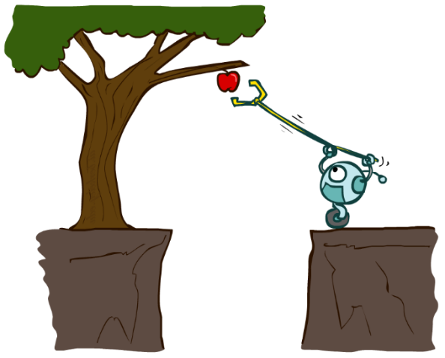
Agent
An agent is an entity that perceives and acts.
A rational agent selects actions that maximize its (expected) utility.
Characteristics of the percepts, environment, and action space dictate techniques for selecting rational actions.
Sensors
Agent
Percepts
Environment
?
Actuators
Actions

Slide 4
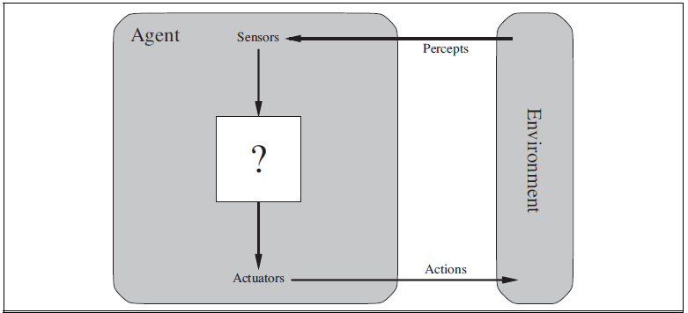
Agents and Environments
Notes:
Agents interact with environments through sensors and actuators.

Slide 5
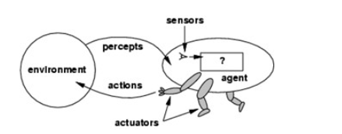
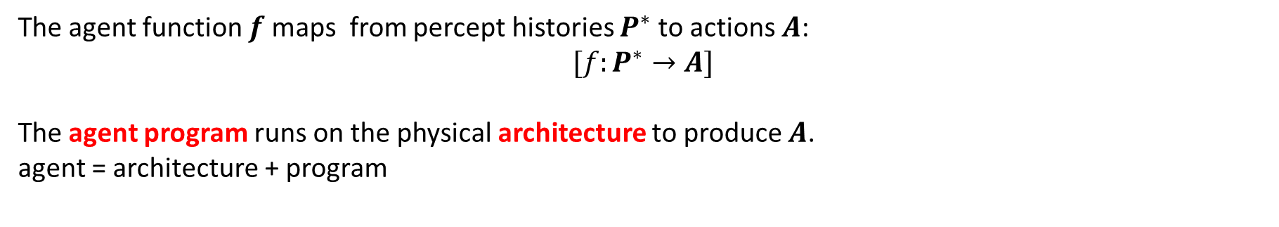
Agents and Environments
The agent function $f$ maps from percept histories $P^{∗}$ to actions $A$:
$$[f:P^{∗}→A]$$
The agent program runs on the physical architecture to produce $A$.
agent = architecture + program

Slide 6

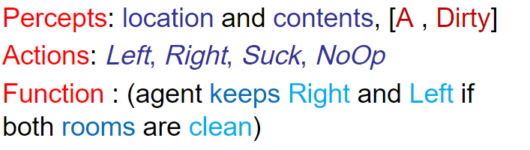
Agents and Environments
A vacuum-cleaner world with just two locations.

Slide 7
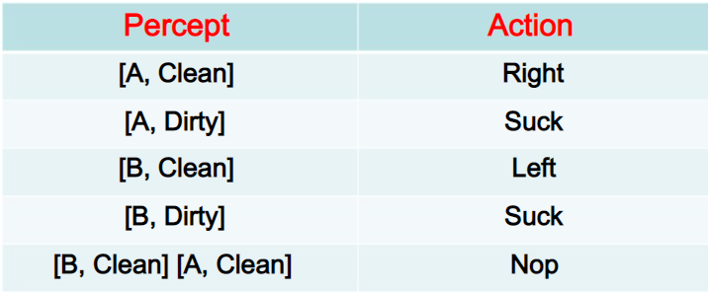
Agents and Environments
A vacuum-cleaner world with just two locations.

Slide 8
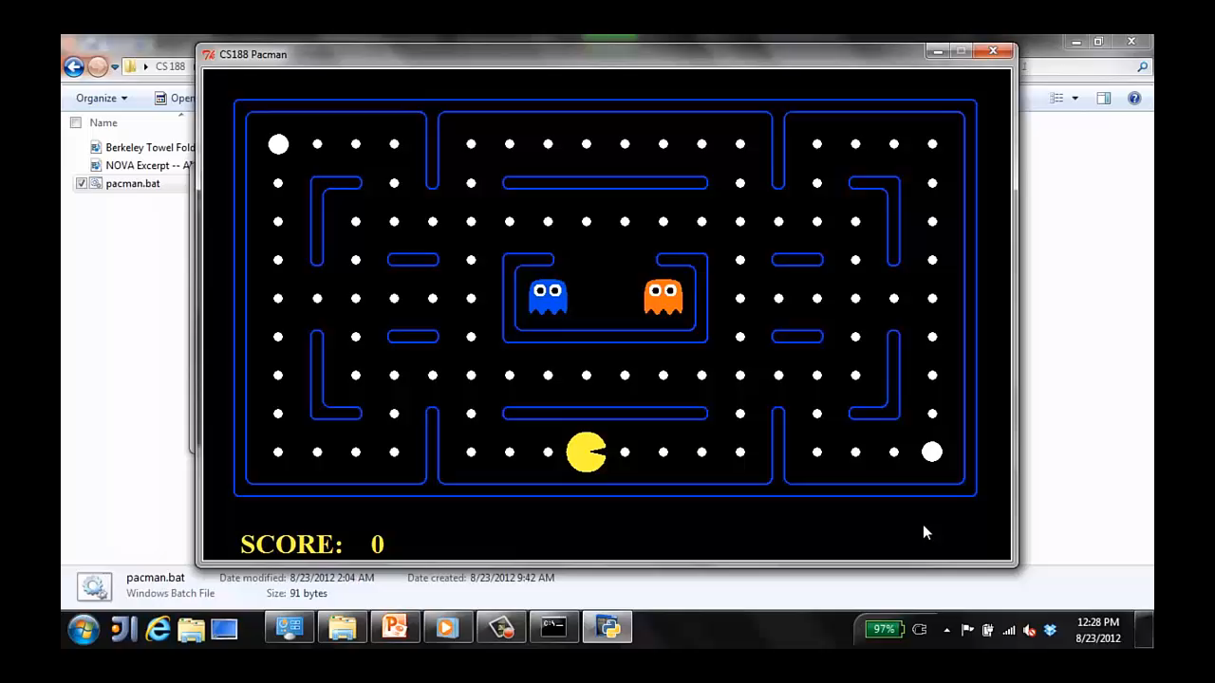
Agents and Environments
Notes:
It is a great sample of agent. Pac-Man is an Agent. Now in this game

Slide 9
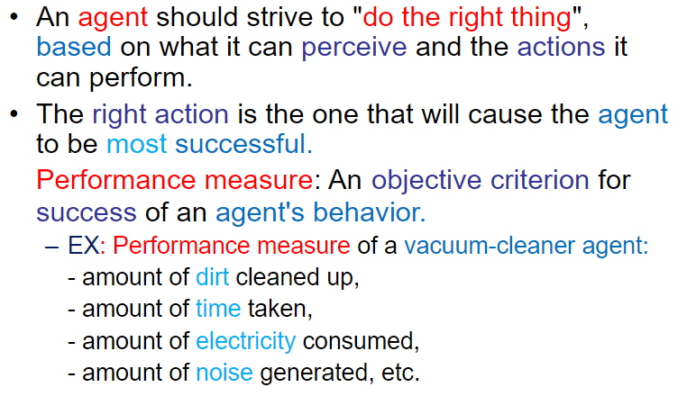
GOOD BEHAVIOR: THE CONCEPT OF RATIONALITY

Slide 10
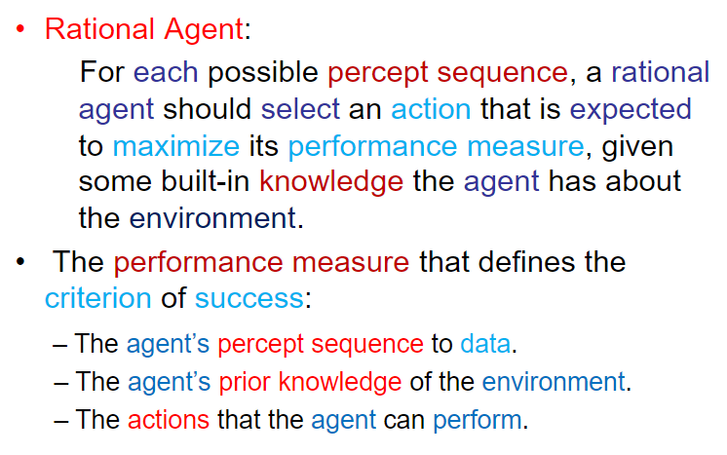
RATIONAL AGENTS

Slide 11
THE NATURE OF ENVIRONMENTS
Specifying the task environment
In our discussion of the rationality of the simple vacuum-cleaner agent, we had to specify the performance measure, the environment, and the agent’s actuators and sensors.
We group all these under the heading of the task environment.
For the acronymically minded, we call PEAS this the PEAS (Performance, Environment, Actuators, Sensors) description.
In designing an agent, the first step must always be to specify the task environment as fully as possible.

Slide 12
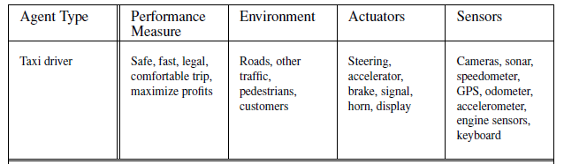
THE NATURE OF ENVIRONMENTS
PEAS description of the task environment for an automated taxi

Slide 13
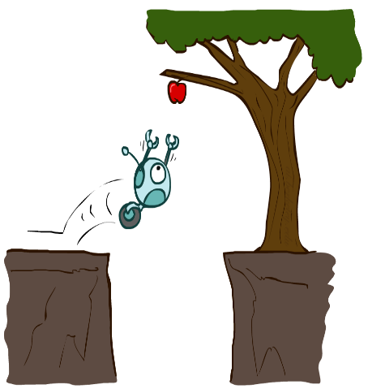
Reflex Agents
Reflex agents:
These agents select actions on the basis of the current percept, ignoring the rest of the percept history
Choose action based on current percept and maybe memory
May have memory or a model of the world’s current state
Do not consider the future consequences of their actions
Notes:
Examples: blinking your eye (not using your entire thinking capabilities), vacuum cleaner moving towards nearest dirt

Slide 14
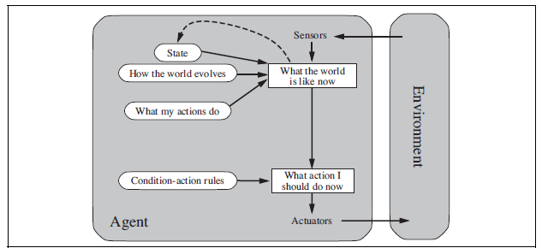
Model-based Reflex agents
Model-based Reflex agents:
Notes:
model-based reflex agents maintain internal state to track aspects of the world that are not evident in the current percept

Slide 15
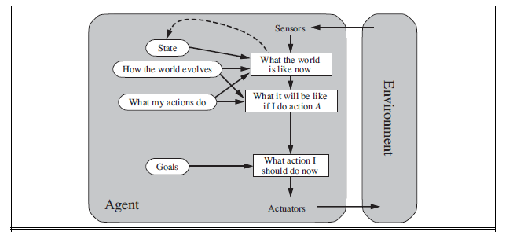
Goal-based agents
Goal-based agents:
Notes:
It keeps track of the world state as well as a set of goals it is trying to achieve, and chooses an action that will (eventually) lead to the
achievement of its goals.

Slide 16
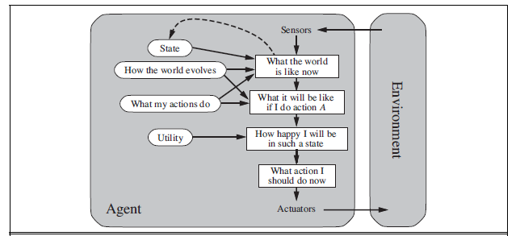
Utility-based agents
Utility-based agents
Notes:
utility-based agents try to maximize their own expected “happiness.”

Slide 17
SUMMARY
All agents can improve their performance through learning
Notes:
utility-based agents try to maximize their own expected “happiness.”

Slide 18
End of the Week…

